Slide 1

Parametric design and Hydrodynamic optimization of a Battery-driven fast Catamaran vessel
Aphrodite Kanellopoulou, George Zaraphonitis, NTUA
Yan Xing-Kaeding, Apostolos Papanikolaou, HSVA
Sustainable and Safe Passenger Ships, 4th March 2020, Athens, Greece

Slide 2
Agenda
Project Outline
CAESES Parametric model
Potential flow calculations
Global Optimization
Conclusions
Surrogate Models
Sustainable and Safe Passenger Ships, 4th March 2020, Athens, Greece
2

Slide 3

Project Outline
Parametric design & hydrodynamic optimization of a catamaran vessel, developed in the framework of the European R&D project TrAM (Transport: Advanced and Modular)
Objectives of TrAM project:
  To develop a series of zero emission fast passenger ferry designs
  To lower production cost by modular design
  To prove the viability of electric-powered high-speed vessels
    A prototype will be built during the project period and put into operation in Stavanger, Norway
Sustainable and Safe Passenger Ships, 4th March 2020, Athens, Greece
3

Slide 4
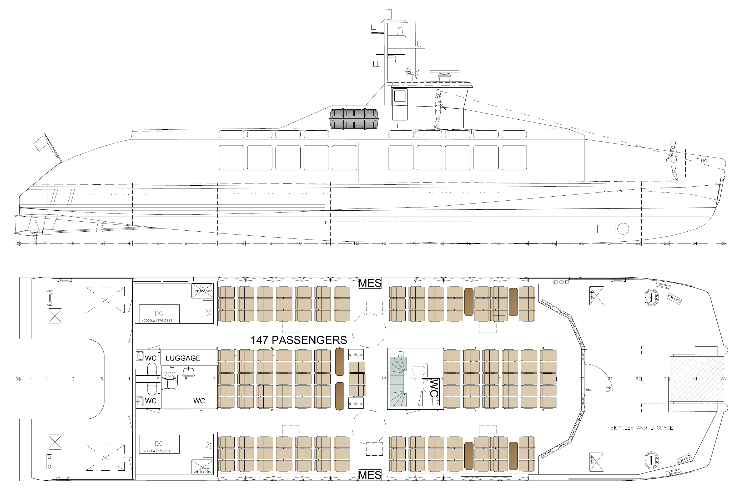
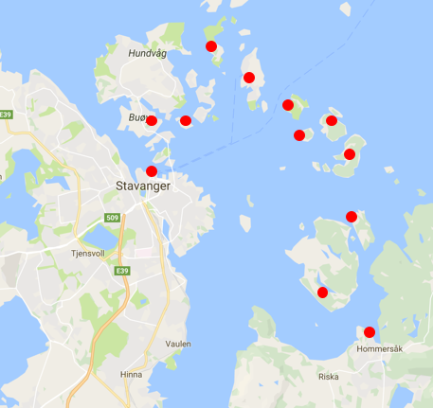
Background information
Sketch of General Arrangement developed by Fjellstrand Shipyard in agreement with vessel operator
Main Dimensions:
  Length OA 31.0m
  Beam OA 9.0m
  Demihull Length OA 30.6m
Passengers: 147 (+20 bikes)
Route: Stavanger – Hommersåk
Sustainable and Safe Passenger Ships, 4th March 2020, Athens, Greece
4

Slide 5
CAESES Parametric model
Based on the background information, a parametric geometry model for the hullform was created by NTUA in CAESES
Set of Parameters
Grid definition
Lackenby Transformation
Surfaces Generation
Sustainable and Safe Passenger Ships, 4th March 2020, Athens, Greece
5

Slide 6
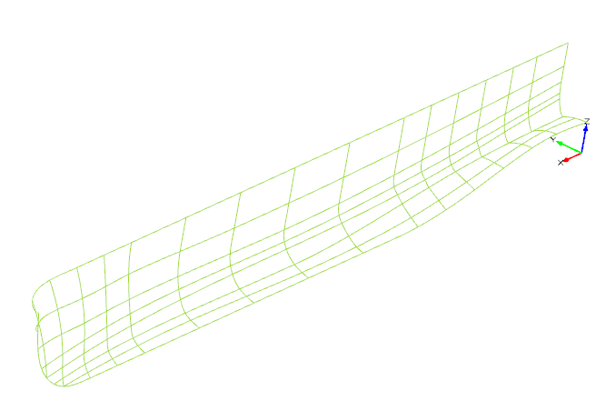
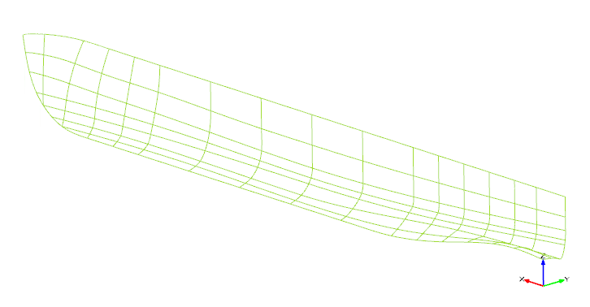
Definition Curves
FInterpolationCurve
Curve3DFrom2PlanarCurves
Interpolation Curve for section
definition
3D curves definition with feature Curve3DFrom2PlanarCurves
Sustainable and Safe Passenger Ships, 4th March 2020, Athens, Greece
6

Slide 7
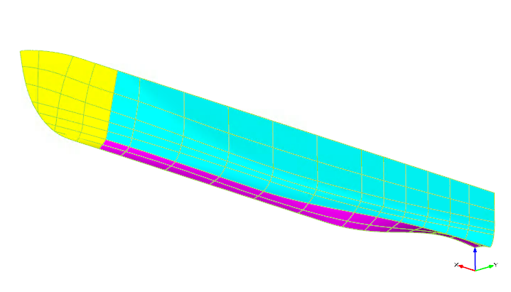
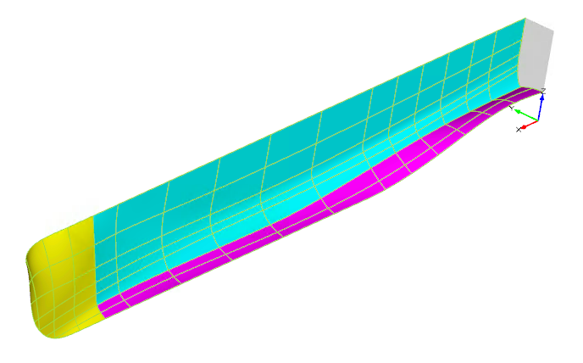
Surfaces
FLoftedSurface
FMetaSurface
Lofted Surfaces for Bow Area
definition
Meta Surfaces for Aft Part & Main Hullform definition
Sustainable and Safe Passenger Ships, 4th March 2020, Athens, Greece
7

Slide 8
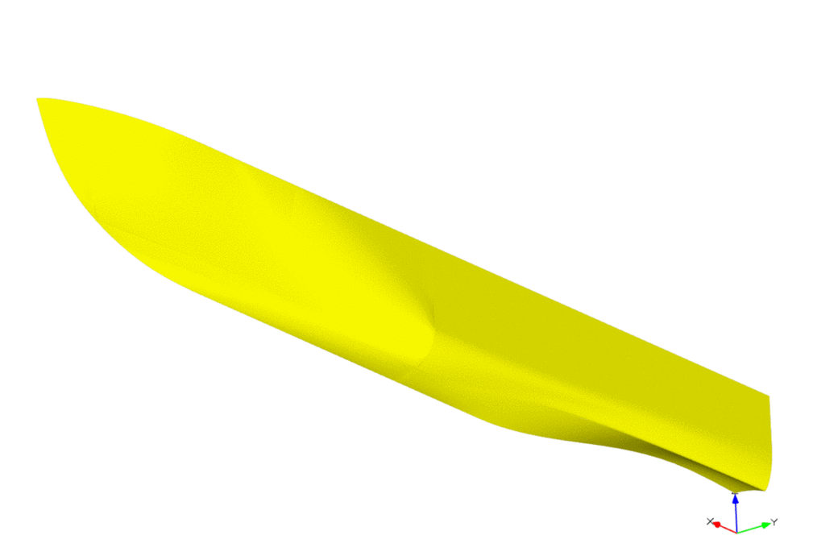
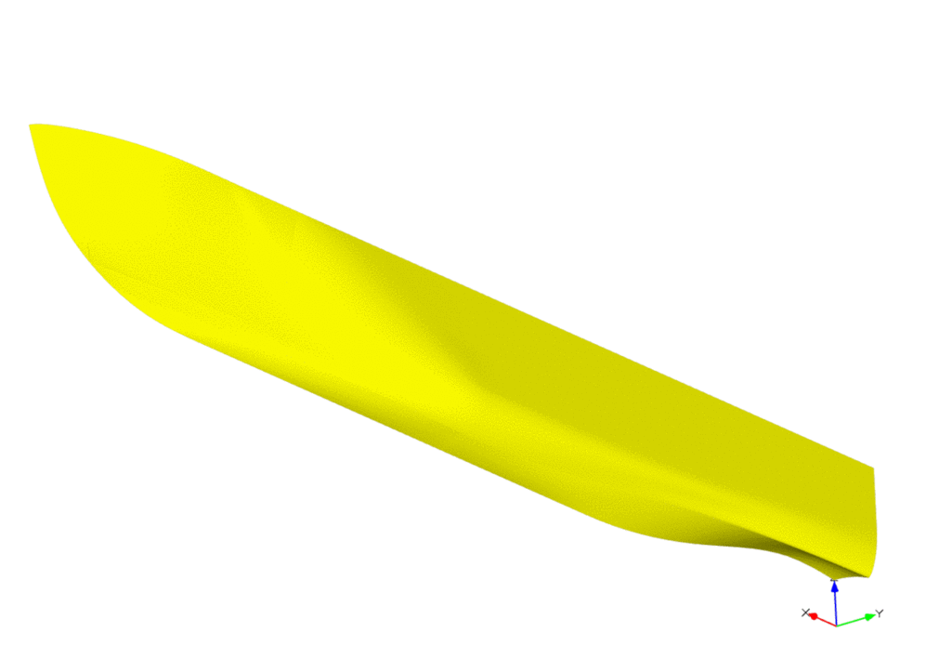
Hullform after Lackenby Transformation
After the hullform definition, a Lackenby transformation was used
Prismatic coefficient adjustment
longitudinal position of the centre of buoyancy adjustment
Sustainable and Safe Passenger Ships, 4th March 2020, Athens, Greece
8

Slide 9
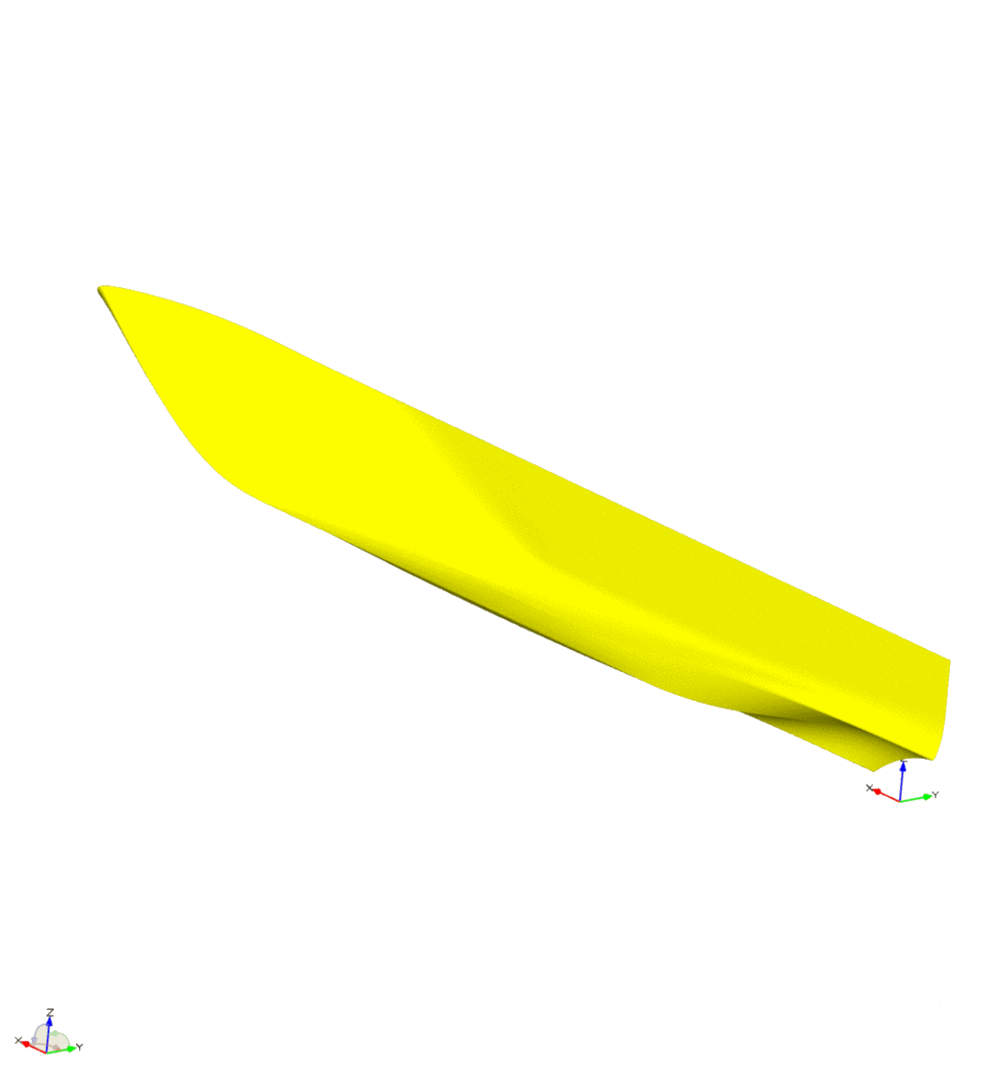
Main Global Parameters
  Waterline Length
Sustainable and Safe Passenger Ships, 4th March 2020, Athens, Greece
9

Slide 10
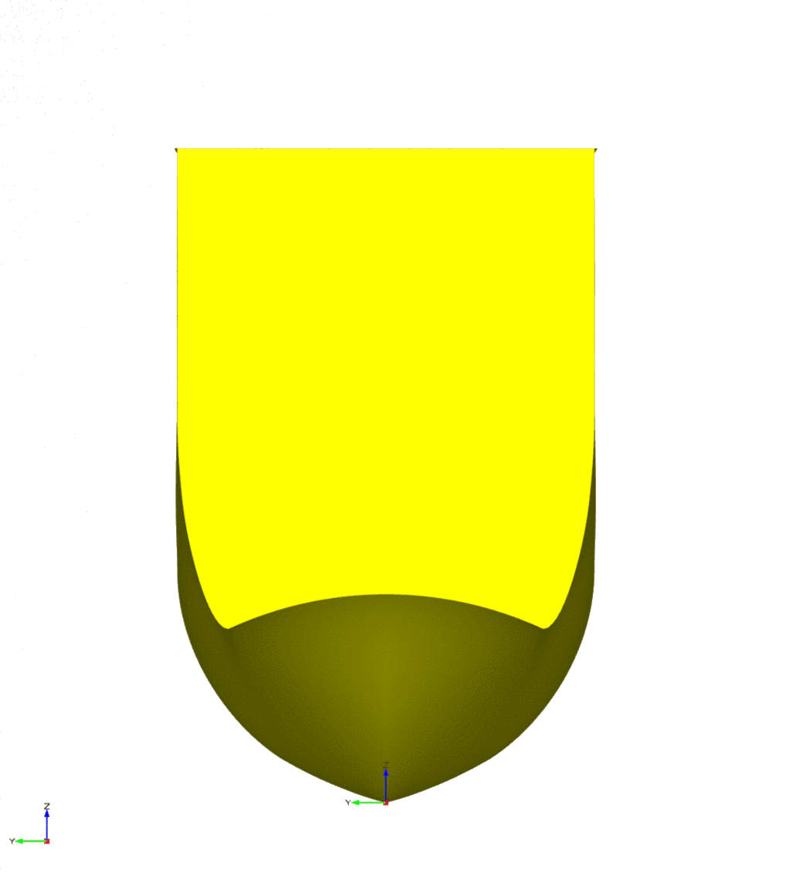
Main Global Parameters
  Waterline Length
  Beam
Sustainable and Safe Passenger Ships, 4th March 2020, Athens, Greece
10

Slide 11
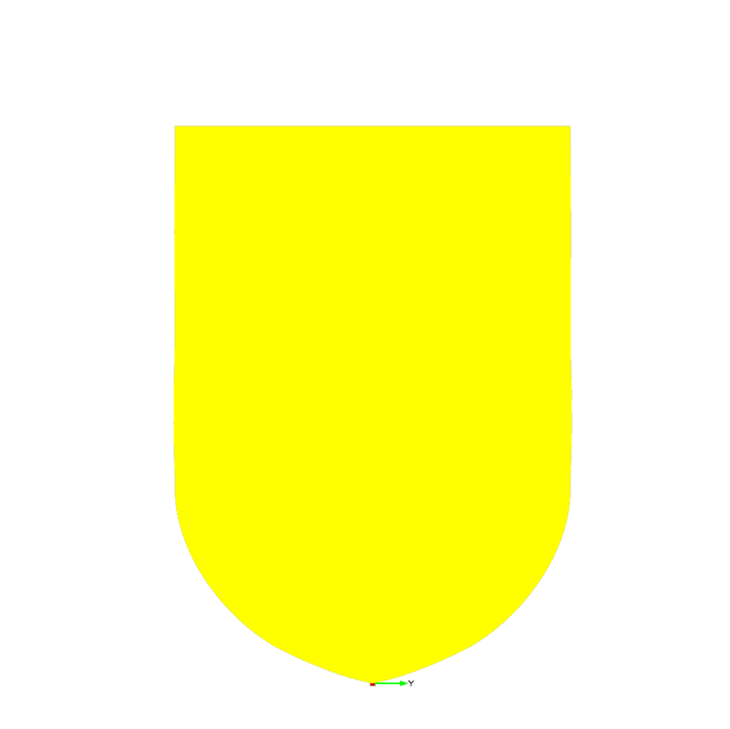
Main Global Parameters
  Waterline Length
  Beam
  Draught
Sustainable and Safe Passenger Ships, 4th March 2020, Athens, Greece
11

Slide 12
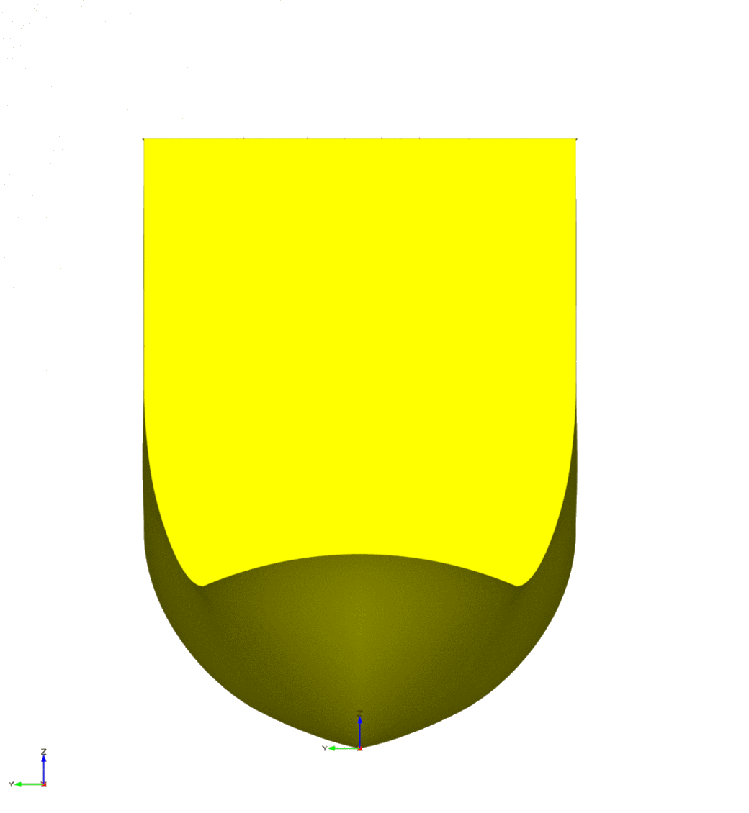
Main Local Parameters
  Transom width
Sustainable and Safe Passenger Ships, 4th March 2020, Athens, Greece
12

Slide 13
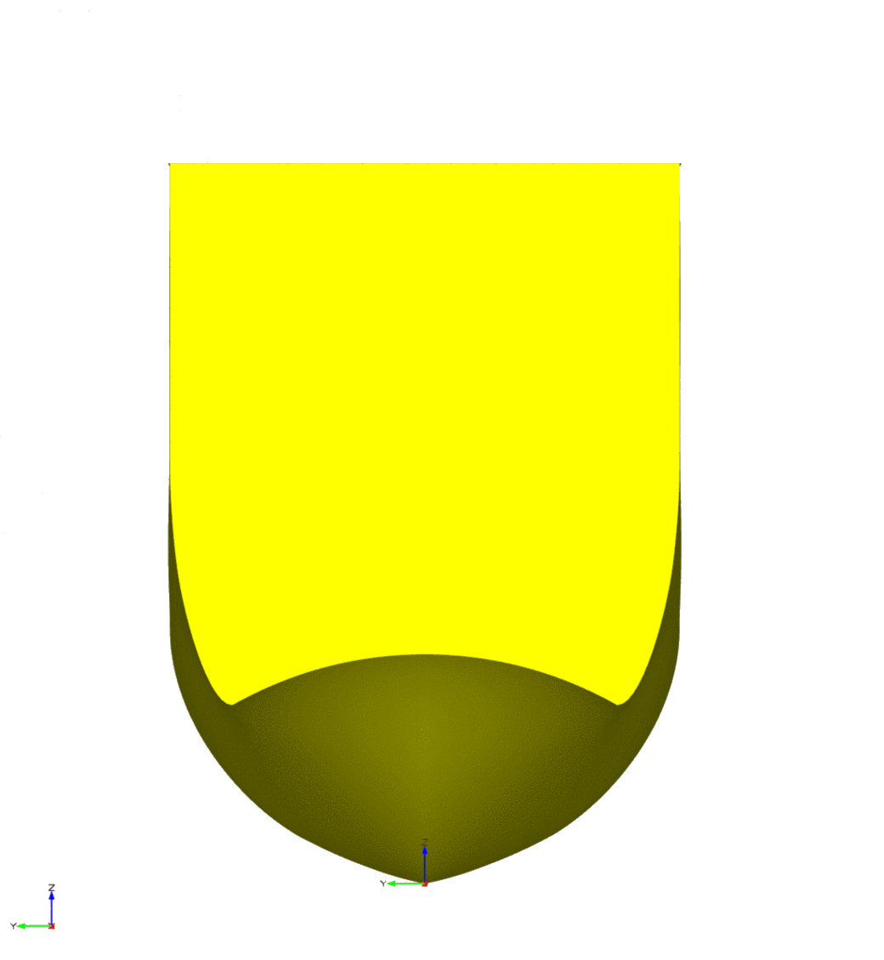
Main Local Parameters
  Transom width
  Transom Chine Height
Sustainable and Safe Passenger Ships, 4th March 2020, Athens, Greece
13

Slide 14
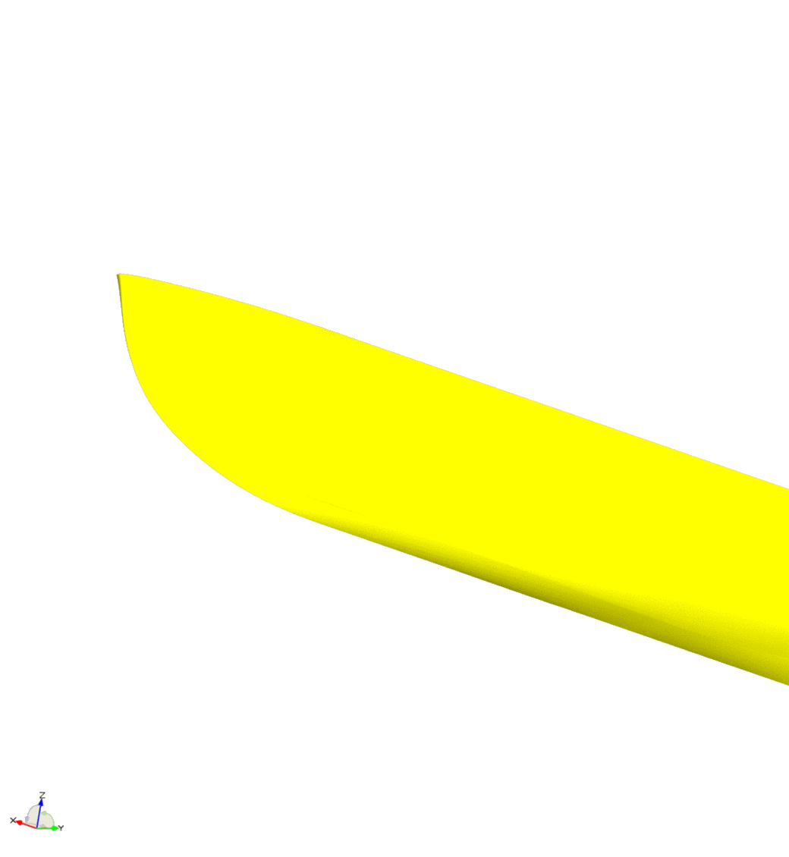
Main Local Parameters
  Transom width
  Transom Chine Height
  Shape of fwd profile
Sustainable and Safe Passenger Ships, 4th March 2020, Athens, Greece
14

Slide 15

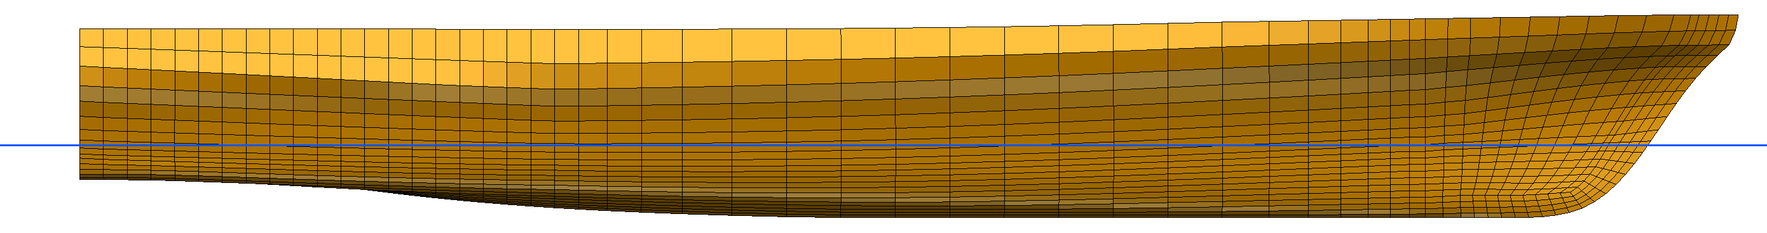
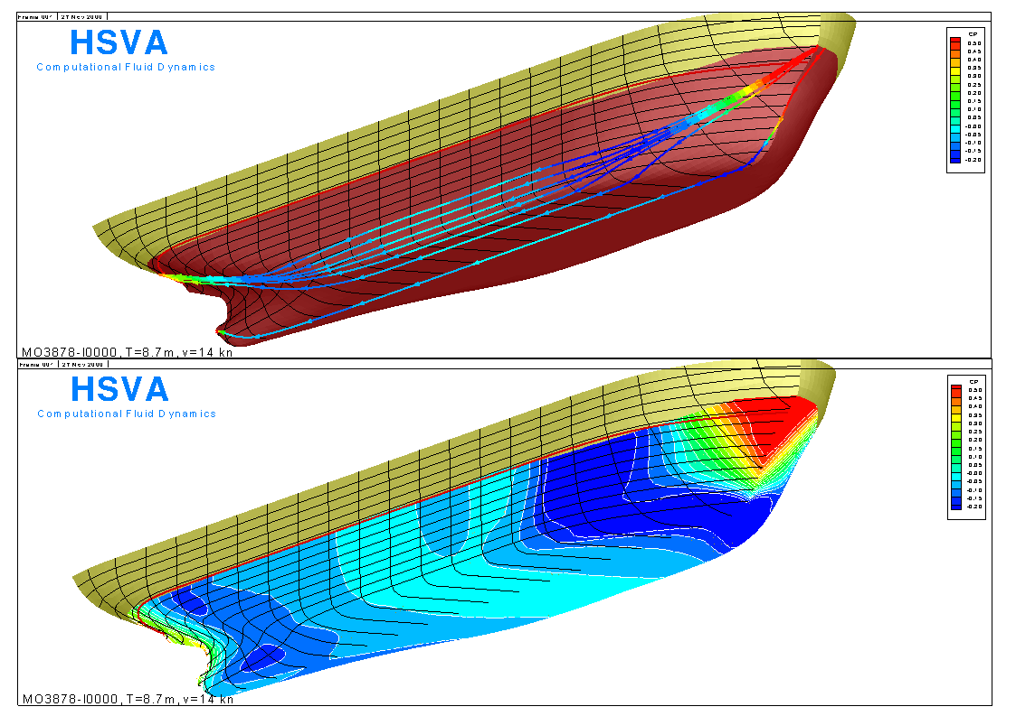
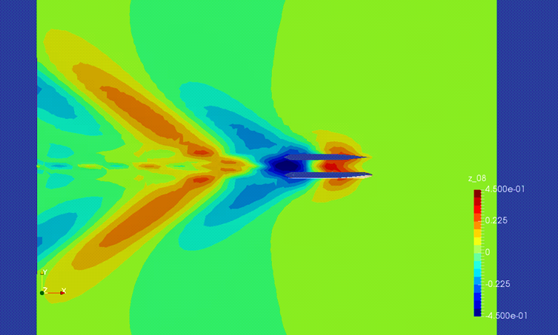
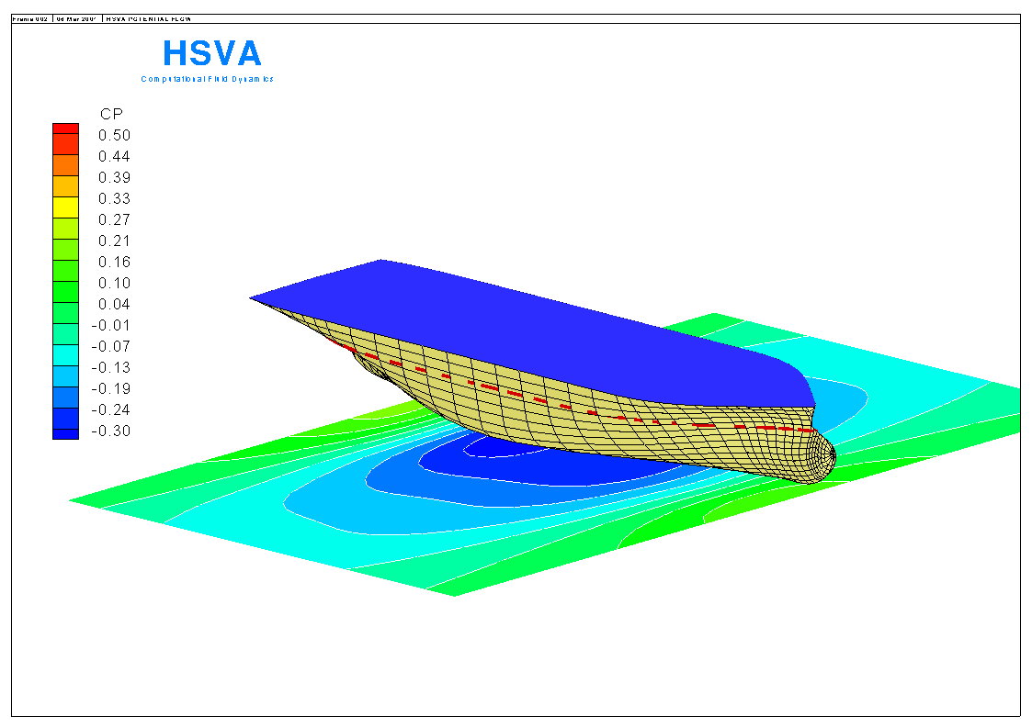

Potential Flow Calculations
Background of HSVA in-house code
ν-Shallo is a potential flow/ 3D panel method for the calculation of the wave resistance
The code estimates viscous resistance by empirical Method (ITTC), while considering
  accurate wetted surface
Accounts for the effect of transom sterns
Flow and wave pattern representation and pressure evaluation
Automatic re-panelling for each iteration
  Ship hull
  Αutomatic control of free surface mesh
Graphical User Interface
Sustainable and Safe Passenger Ships, 4th March 2020, Athens, Greece
15

Slide 16
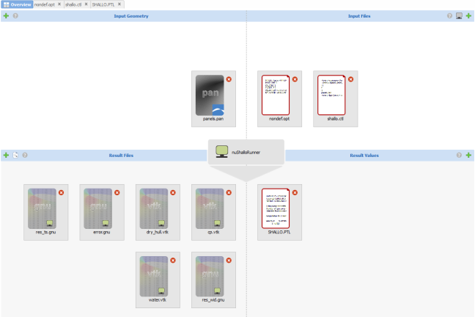
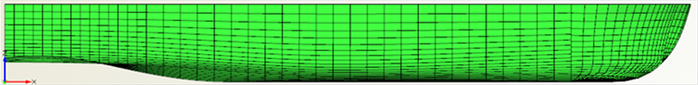
ν-SHALLO Integration into CAESES
ν -SHALLO was the first of HSVA’s simulation tools with completed integration into the CAESES framework using the SoftwareConnector
Automatic hull form optimisation in Linux or Windows environment
Geometry Panelization file
ν -SHALLO input files
ν -SHALLO result files
Sustainable and Safe Passenger Ships, 4th March 2020, Athens, Greece
16

Slide 17
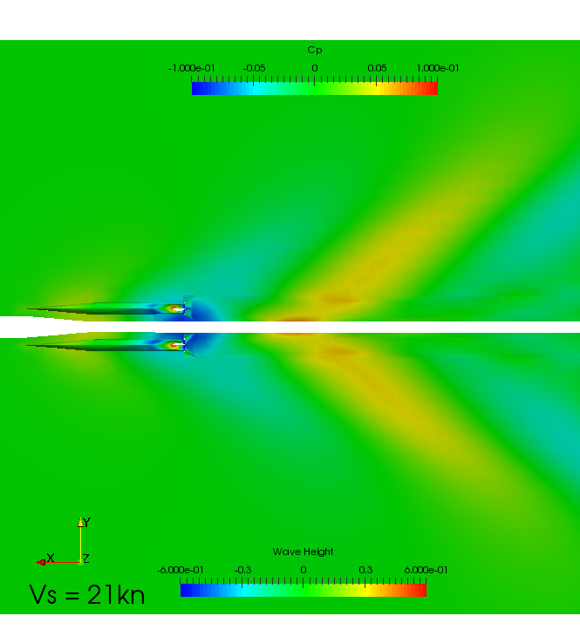
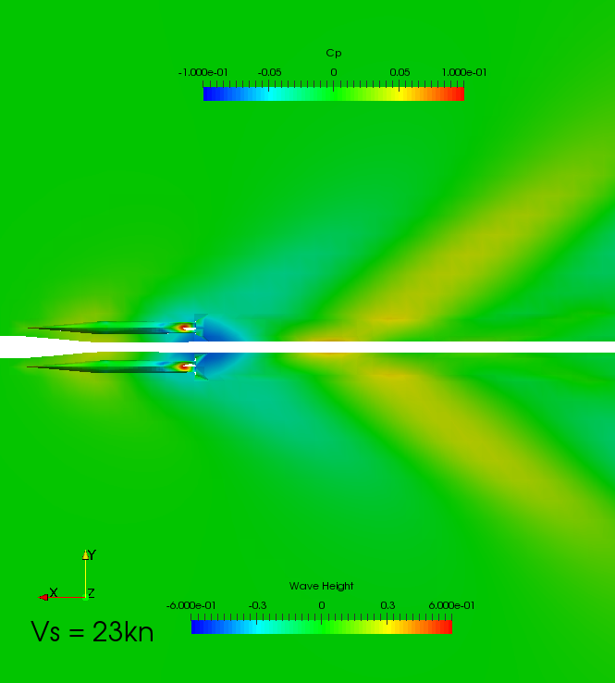
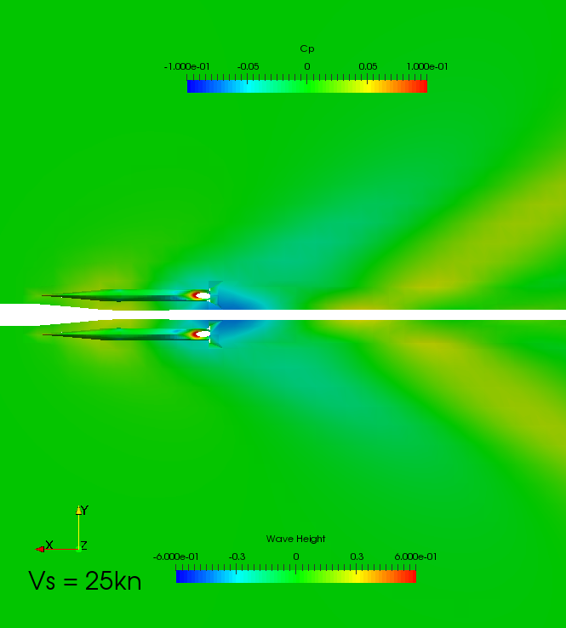
Design of Experiments (DoE) for Stavanger Demonstrator using ν-SHALLO
Stavanger Demonstrator DoE | Description | Overall Beam of 9.0m
(Global) Design Variables for demihull | L_{WL} | 29~30.2m
 | Beam | 2~2.6m
 | Initial Draught | 1.2~1.6m
 | Transom width | 0.8~0.85
Design Conditions | Weights | Δ1, Δ2, Δ3
 | Ship Speed | 21, 23, 25 kn
Design Constraints | Battery space | 1634x2029mm
Design Results | No. of calculations | 1800
Evaluated Variables |  | RT
 |  | Sinkage/Trim
ν-SHALLO indicative results for a hullform design variant
Vs=21kn Vs=23kn Vs=25kn
Sustainable and Safe Passenger Ships, 4th March 2020, Athens, Greece
17

Slide 18
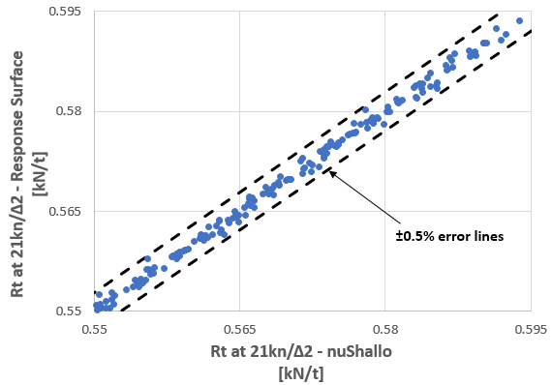
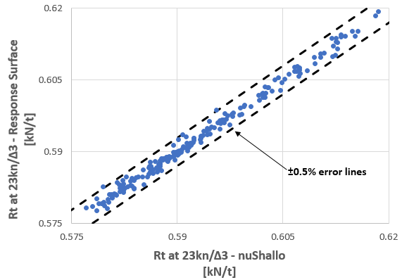
Use of Surrogate Models instead of Direct Calculations for Reduced Computational Time
Various surrogate models were generated and tested for calm water resistance calculation based on ν-Shallo results.
Most accurate and fast method: MARS (Multivariate Adaptive Regression Splines) (error ≤ ±0.5%).
Surrogate models replaced direct calculations by CFD tools in optimization studies.
Δ2 Displacement at 21kn
Δ3 Displacement at 21kn
Sustainable and Safe Passenger Ships, 4th March 2020, Athens, Greece
18

Slide 19
Global Optimization Studies
Global optimization studies performed using NSGA-II genetic algorithm
Objective of the study: to minimize calm water resistance of the bare hull
To obtain hullform with superior characteristics in a range of displacements & speeds, the following weighted objective function is used:
Constraints:
  Minimum demihull width & height for installation of batteries
  Height of tunnel at centreline for propeller installation
R_{T} = 0.12R_{T_21kn, Δ1} + 0.20R_{T_23kn, Δ1} + 0.08R_{T_25kn, Δ1} +
0.09R_{T_21kn, Δ2} + 0.15R_{T_23kn, Δ2} + 0.06R_{T_25kn, Δ2} +
0.09R_{T_21kn, Δ3} + 0.15R_{T_23kn, Δ3} + 0.06R_{T_25kn, Δ3}
Sustainable and Safe Passenger Ships, 4th March 2020, Athens, Greece
19

Slide 20
Design Variables
According to the 1st Design Scenario:
  catamaran’s length overall fixed at 31.0m
  beam overall fixed at 9.0m
Design variables considered:
  Waterline Length
  Demihull’s Beam
  Initial Draught
  Transom width
Sustainable and Safe Passenger Ships, 4th March 2020, Athens, Greece
20

Slide 21
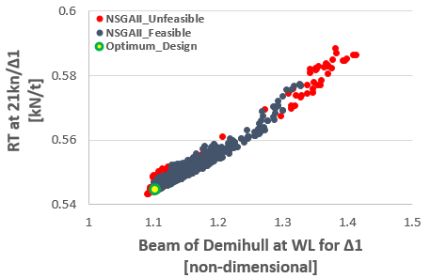
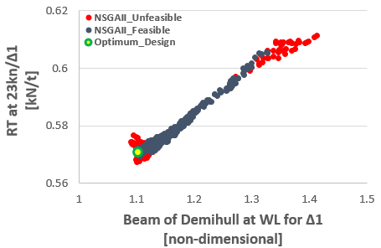
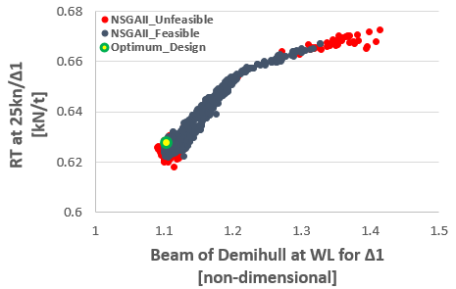
Global Optimization Results
Total Designs Produced: 1000
  824 Feasible
  176 Unfeasible
Displacement: Δ1
Vs=21kn Vs=23kn Vs=25kn
Sustainable and Safe Passenger Ships, 4th March 2020, Athens, Greece
21

Slide 22
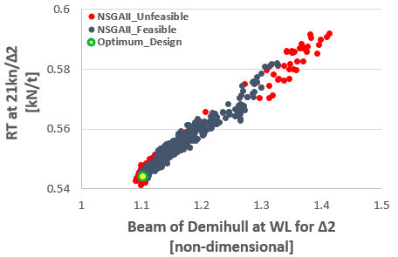
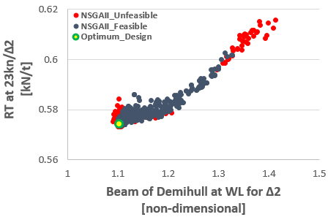
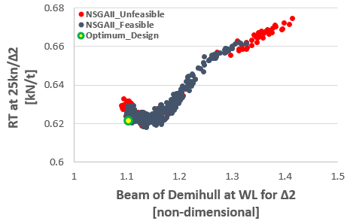
Global Optimization Results
Total Designs Produced: 1000
  824 Feasible
  176 Unfeasible
Displacement: Δ2
Vs=21kn Vs=23kn Vs=25kn
Sustainable and Safe Passenger Ships, 4th March 2020, Athens, Greece
22

Slide 23
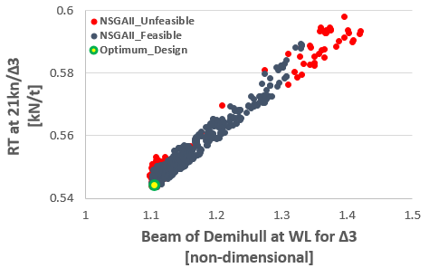
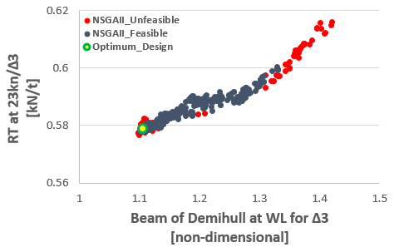
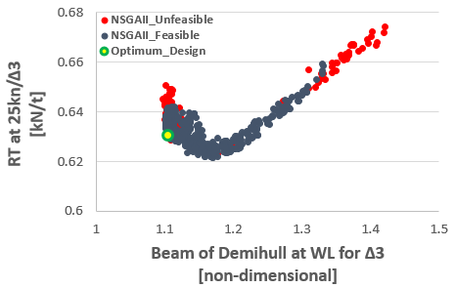
Global Optimization Results
Total Designs Produced: 1000
  824 Feasible
  176 Unfeasible
Displacement: Δ3
Vs=21kn Vs=23kn Vs=25kn
Sustainable and Safe Passenger Ships, 4th March 2020, Athens, Greece
23

Slide 24
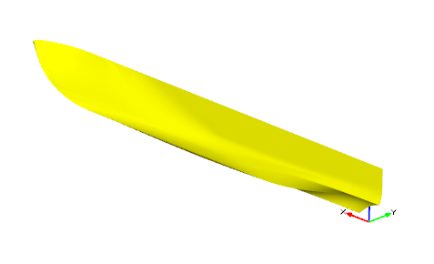
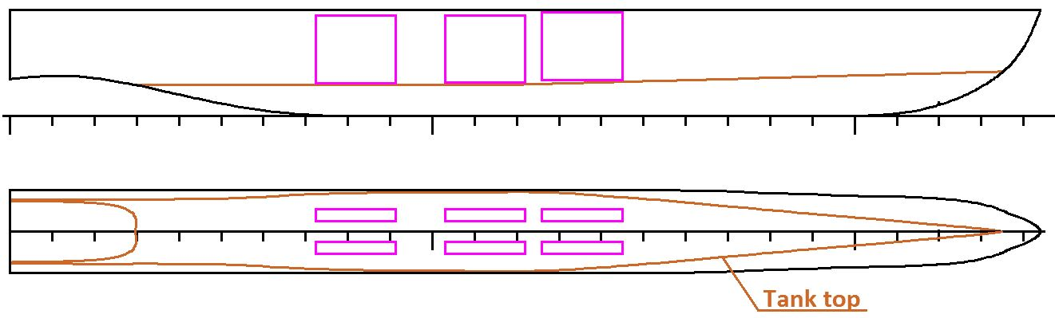
Optimum Design Selection
  Based on hydrodynamic characteristics and construction/maintenance issues, an overall optimum design was selected
 | at Δ1 | at Δ2 | at Δ3
LWL | 29.29 | 29.34 | 29.39
Beam at WL | 2.442 | 2.442 | 2.444
Draft | 1.226 | 1.272 | 1.317
Rt_21 kn /Δ | 0.558 | 0.599 | 0.642
Rt_23 kn /Δ | 0.588 | 0.620 | 0.663
Rt_25 kn /Δ | 0.658 | 0.684 | 0.717
Sustainable and Safe Passenger Ships, 4th March 2020, Athens, Greece
24

Slide 25
Conclusions & Next Steps
  Parametric model for fast catamaran design developed by NTUA in CAESES, integrated with HSVA’s ν-Shallo
  Development of surrogate models for calm water resistance on the basis of CFD results
  Multi-objective Optimization studies using NSGA-II genetic algorithm
  Conducted global optimization studies show that:
    Demihull hullforms with smaller beam have lower calm water resistance for lightest displacements
    At higher speeds and displacements, beamier hullforms are performing better
  Based on hydrodynamic characteristics and construction/maintenance issues an overall optimum was selected for more refined optimisation
  Local hullform optimization for improved resistance and propulsion characteristics are currently in progress using HSVA’s CFD viscous flow RANS solver FreSCo+
  The resulting hullform will be tank-tested by HSVA and used for building of the Stavanger prototype
Sustainable and Safe Passenger Ships, 4th March 2020, Athens, Greece
25

Slide 26
Thank you for your attention
Parametric design and Hydrodynamic optimization of a Battery-driven fast Catamaran vessel
Aphrodite Kanellopoulou, George Zaraphonitis, NTUA
Yan Xing-Kaeding, Apostolos Papanikolaou, HSVA
Sustainable and Safe Passenger Ships, 4th March 2020, Athens, Greece

