Slide 1
Ensuring efficiency and safety in electric vessels
Updated regulations

Slide 2
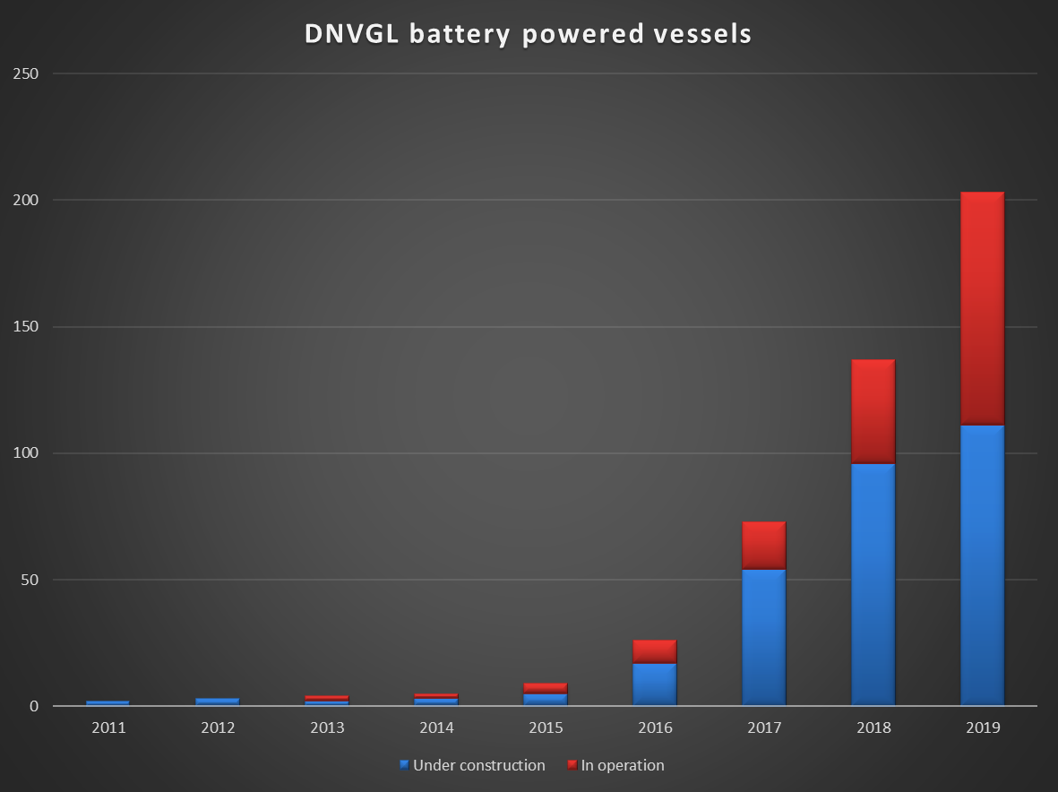

Slide 3
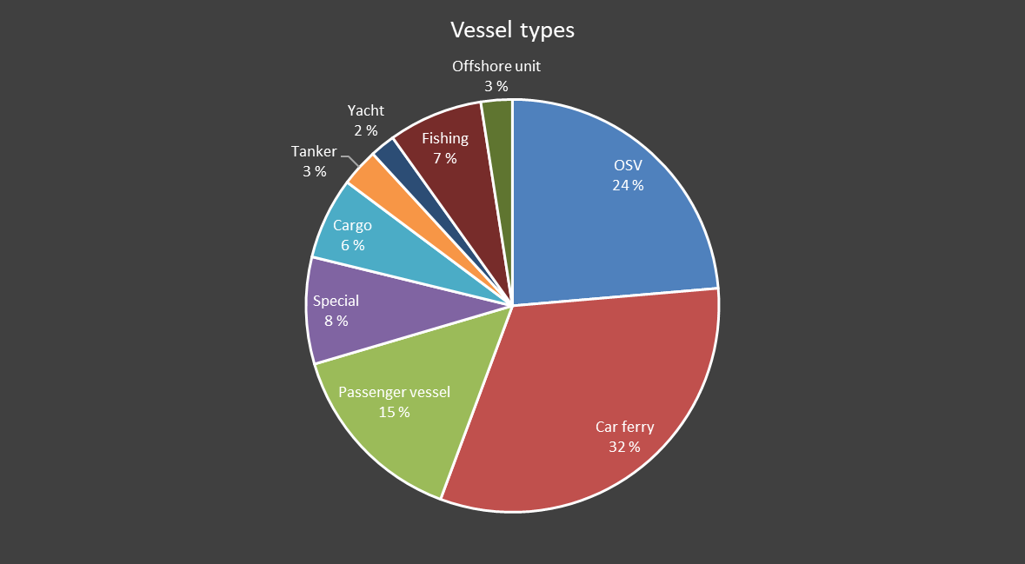
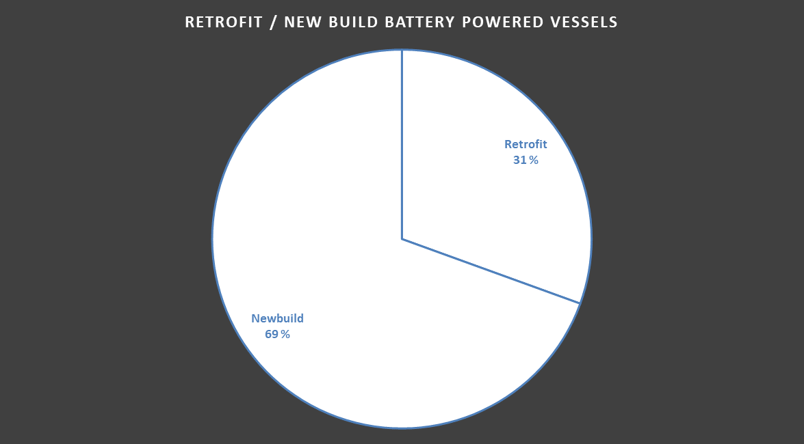

Slide 4
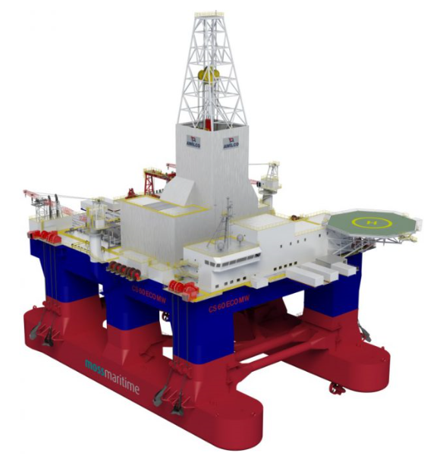
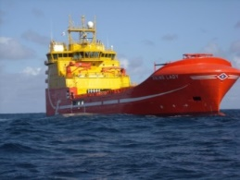
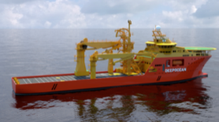

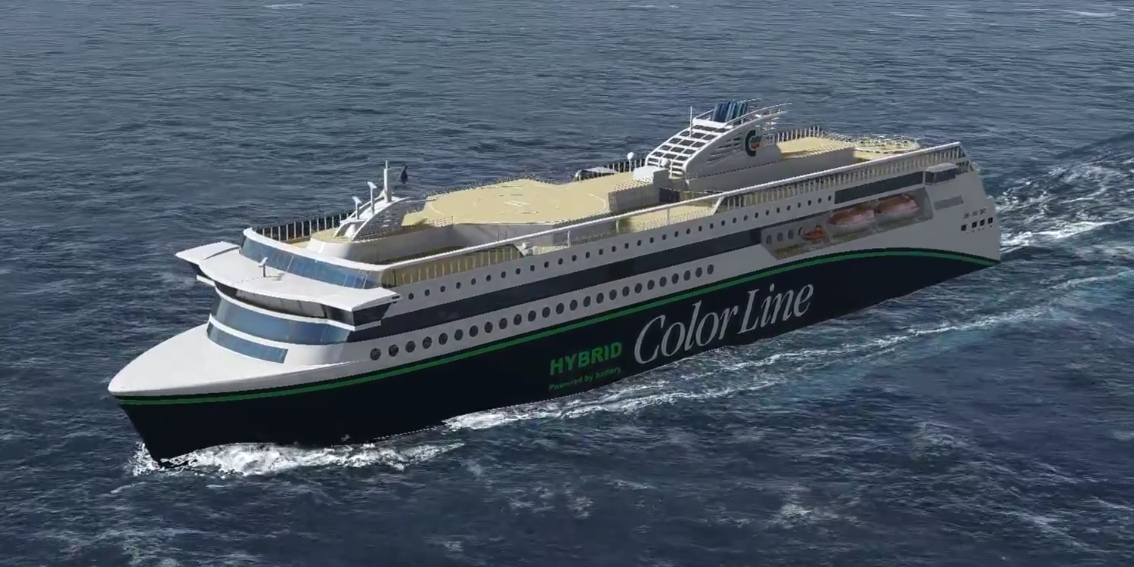

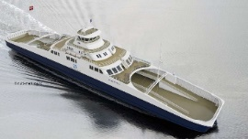

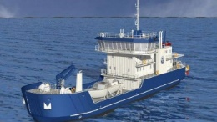
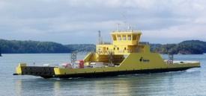
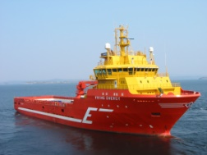
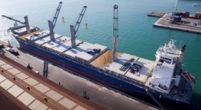
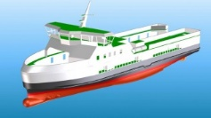
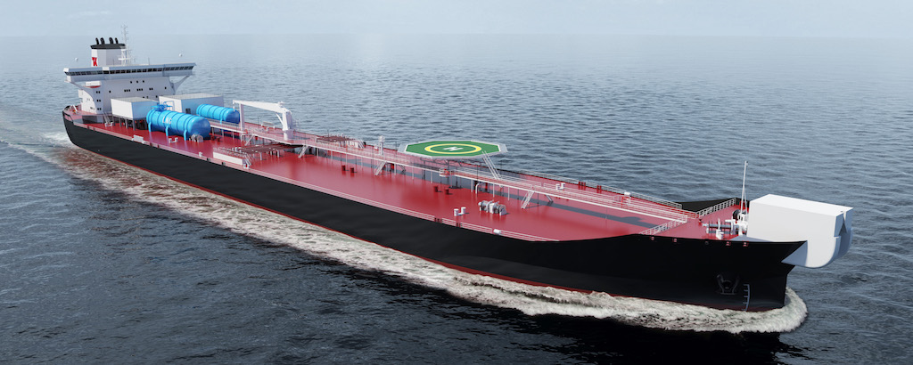
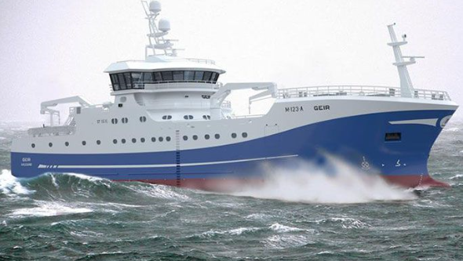
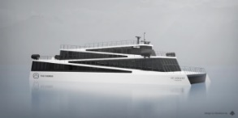
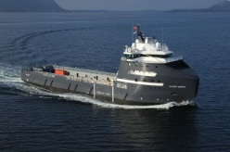
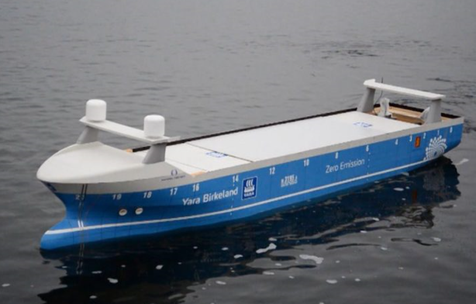
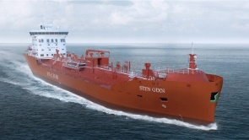
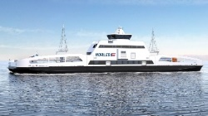
DNV GL Classed and pre classed vessels with batteries

Slide 5
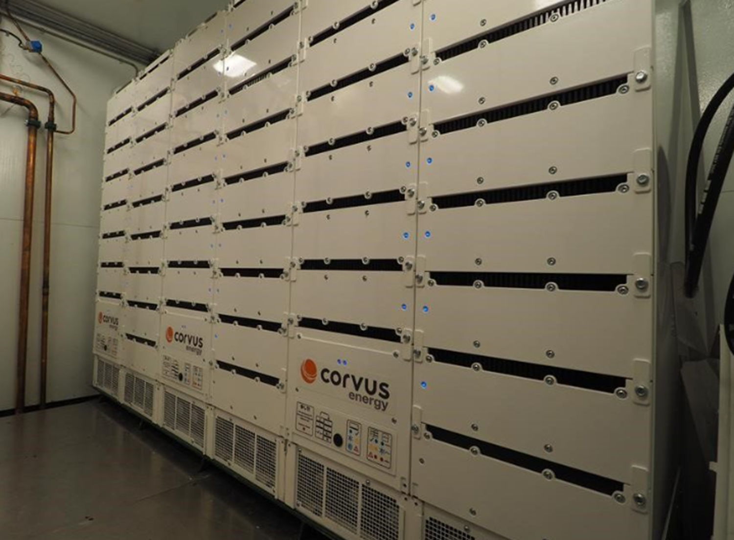
Arrangement of battery space [2.2] and [3.2.1.1]
Part 6 Chapter 2 - Propulsion, power generation and auxiliary systems
Battery space behind collision bulkhead
Only equipment associated with the battery system shall be placed within the battery space
Avoid pipes running through battery space
Pure battery driven vessels needs
two separate battery spaces

Slide 6
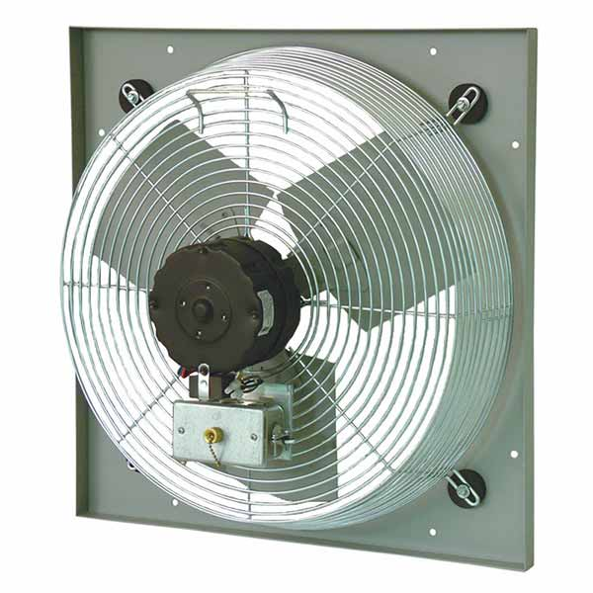
Ventilation of battery space [2.3]
Part 6 Chapter 2 - Propulsion, power generation and auxiliary systems
  Mechanical ventilation of the battery space
  Ventilation in case of thermal runaway
  Ventilation pipes from battery space independent
  of other ventilation
  Battery type dependent over pressure / under pressure
  of battery space
  Gas detection in battery space

Slide 7
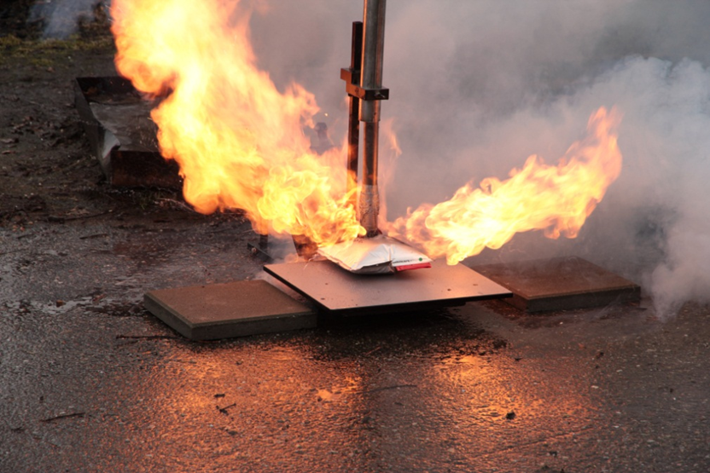
Fire safety of battery space [2.4]
Part 6 Chapter 2 - Propulsion, power generation and auxiliary systems
Fire integrity as for machinery space of category A and with A60 towards high fire risk areas (e.g. the room with diesels engines)
Fire detection by smoke and temperature detectors
Fire extinguishing by fixed fire fighting system
Gas based extinguish systems
need two releases
Saltwater extinguish medium
shall only be used as last resort

Slide 8

Energy Management System, EMS
Part 6 Chapter 2 - Propulsion, power generation and auxiliary systems
Calculation of available energy from batteries
Calculation of available power from the batteries.
Calculation of remaining time of supply from batteries
Changed the requirements for calculation of needed battery capacity such that the capacity is not any longer related to a specific operation/route.
Calculation remaining time that the vessel can operate on EES systems after worst case failure scenario.

Slide 9
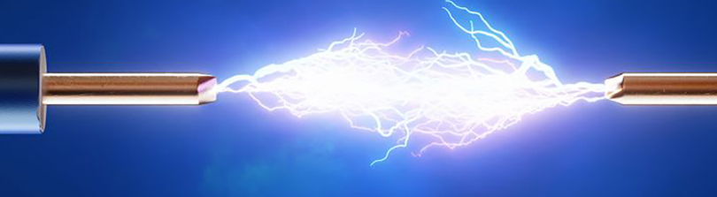
Battery system design [4.1]
Part 6 Chapter 2 - Propulsion, power generation and auxiliary systems
Clarified requirements for creepage and clearance distances, earth faults, electrical insulations and cooling liquid leakage.
Strengthened requirements for liquid cooled battery systems
Clarified requirements for ingress protection of battery systems.

